Slide 4
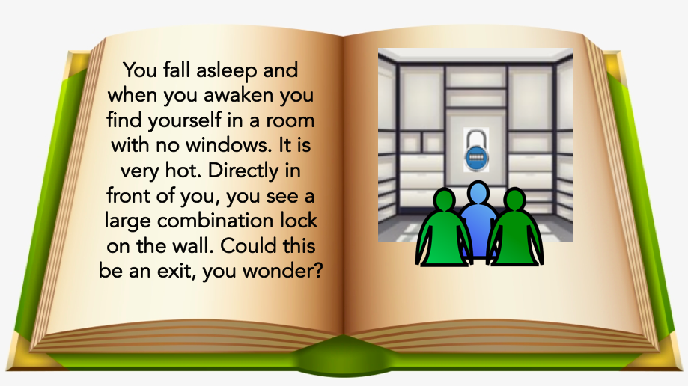

Slide 12
THE END

